Slide 1

PyTech Titans
Team members:
Navya J
Rakshitha Kori
Soumya V
Triveni K O
Yashoda H
3BR23EC057
3BR23EC154
3BR23EC157
3BR23EC170
3BR23EC185

Slide 2
Player Performance Analysis
Performance Analysis is a specialized discipline that provides athletes and coaches with objective information that helps them understand performance. This process is underpinned by systematic observation, which provides valid, reliable and detailed information relating to performance.
To Analyze a Player Performance:
Define Metrics: Determine which metrics are most important for evaluating player performance in the specific sport or activity.
Collect Data: Gather relevant data on each player's performance.
Statistical Analysis: Apply statistical methods to analyze the data collected.

Slide 3
Problem Statement
Analyze player performance data to identify key factors that contribute to individual and team success.
By using Python, we aim to uncover patterns, trends, and predictive insights that can guide player development, team strategies, and performance optimization.

Slide 4
Objective
To analyze player performance data using Python
To gain insights into the factors that contribute to successful performance
To identify top-performing players based on statistical analysis.
To provide data-driven insights that can help improve team performance and player development strategies.

Slide 5
Algorithm
Create class Player and define functions to update the player stats, batting average, bowling average, and to display the player’s stats.
Create another class Team and define functions to add players, update player details, delete player, and display players.
Create object team and calling class Team
Asking the user to add, update , delete, display or exit the input.

Slide 6
Implementing CRUD Operations
Create: Allow users to add new players to the system, with options to specify their details and attributes.
Read: Provide methods to retrieve player information, such as their statistics, performance metrics, and biographical data.
Update: Enable users to modify player data, such as updating their stats or changing their team affiliation
Delete: Allows user to delete player's information.

Slide 7
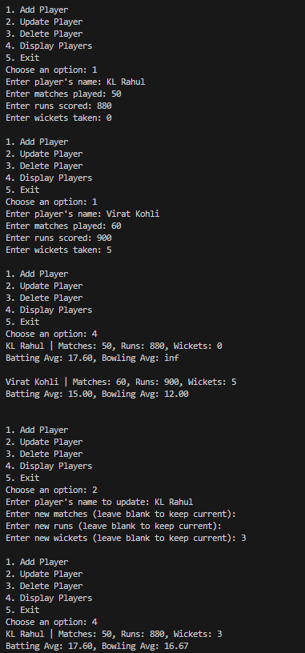
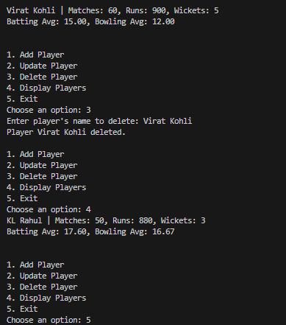
Output

Slide 8
Conclusion
This project effectively analyzed player performance data without the use of external libraries or modules, relying on core Python functionalities.
Through custom-built functions and manual data manipulation, we explored key performance metrics such as batting and bowling average.
Future work could involve incorporating Python libraries such as Pandas or Matplotlib to automate and enhance the analysis, enabling more efficient handling of larger datasets and deeper insights.

Slide 9
Future Enhancement
AI-Based Predictive Modeling:
Implement machine learning algorithms to predict future player performance trends, injury risks, or player fatigue based on historical data and real-time match conditions.
Helps coaches make proactive decisions regarding player rotation, rest periods, and strategic planning for future matches.
Incorporation of Wearable Technology Data:
Integrate data from wearable devices (e.g., GPS trackers, heart rate monitors) that provide real-time information on player movements, speed, stamina, and recovery.

Slide 10
Thank you

